Slide 1
CASE INTERVIEW
DATA ANALYST
by Dr. Ahmed Eshwihdi

Slide 2
Content
TASK 1 – IDENTIFYING USE CASES BASED ON AVAILABLE DATA
TASK 2 – PRIORITISING USE CASES
TASK 3 – IMPLEMENTING A TOP PRIORITY USE CASE
Questions

Slide 3
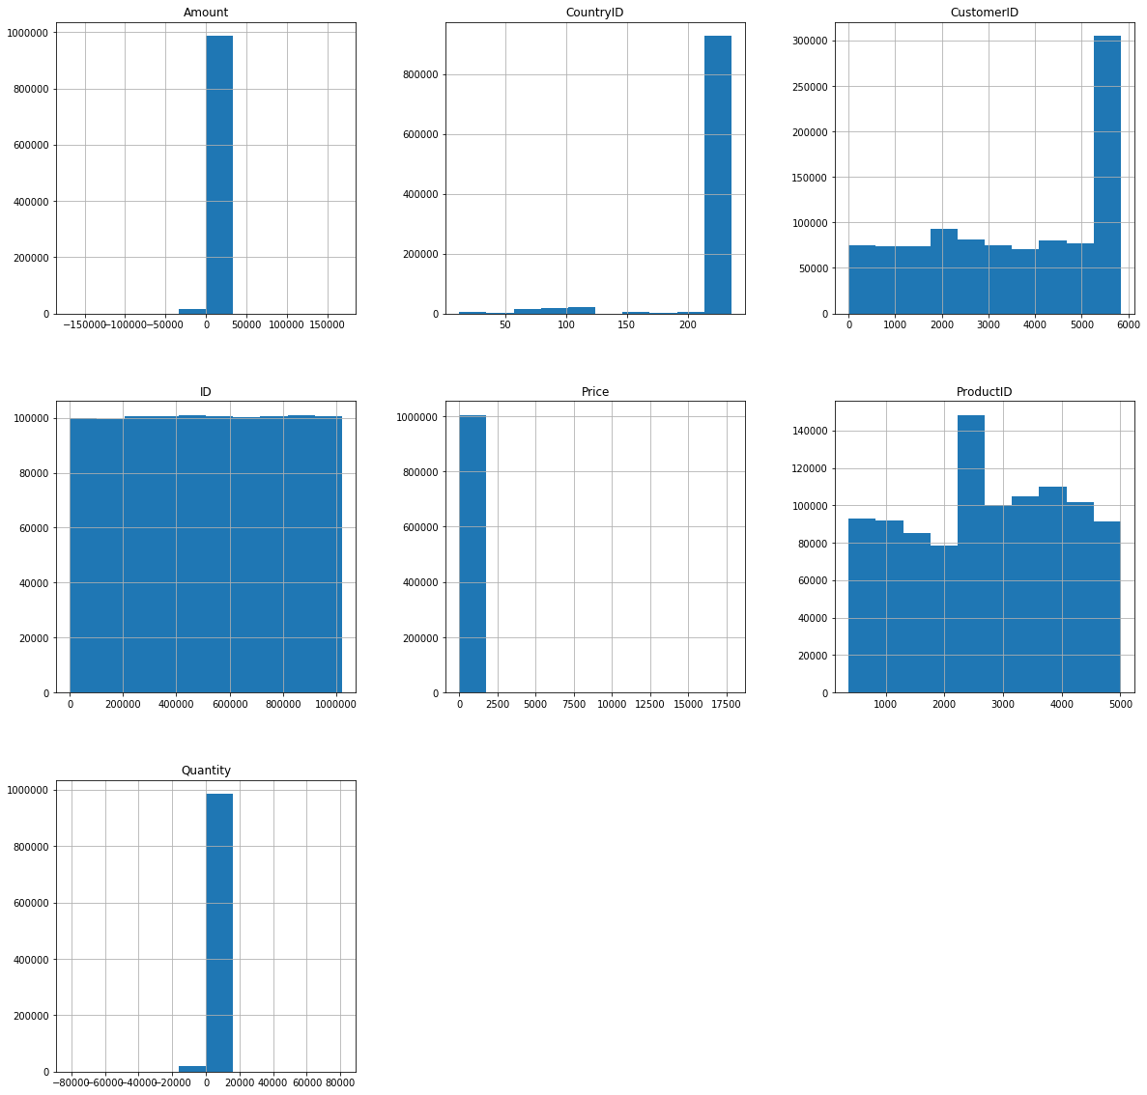
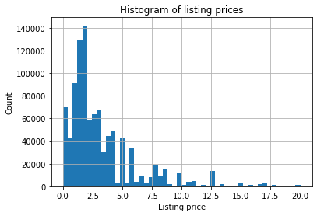
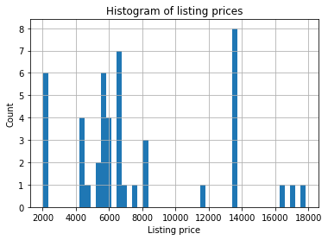
Numerical features overview

Slide 4
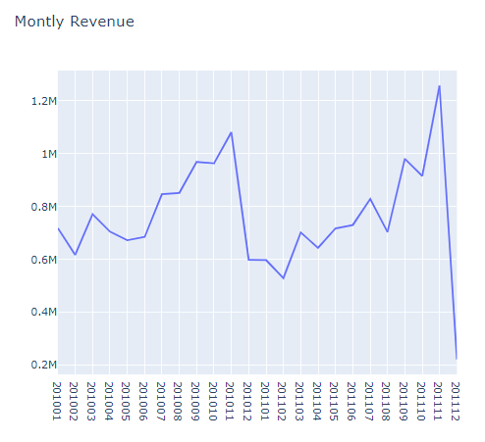
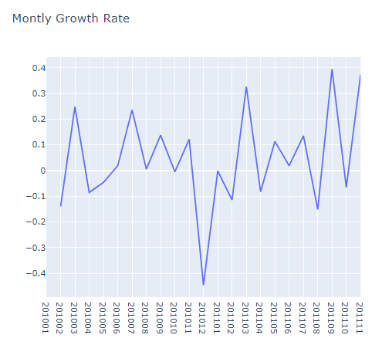
Monthly Revenue & Growth rate

Slide 5
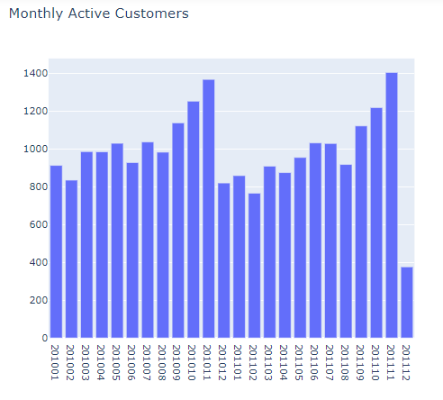
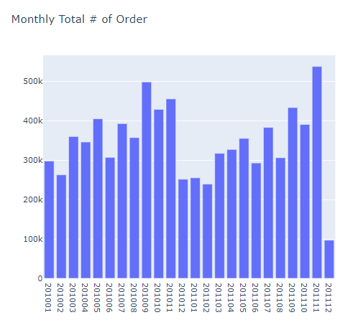
Monthly Active Customers & Order Count

Slide 6
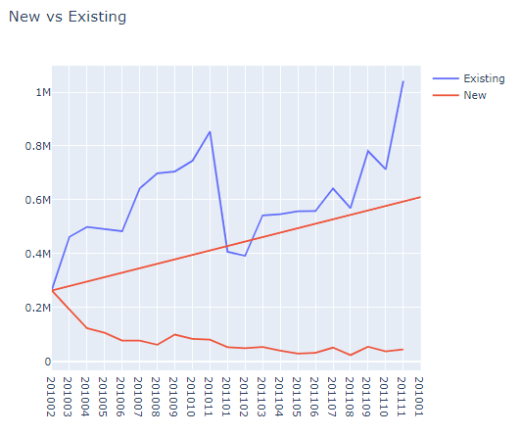
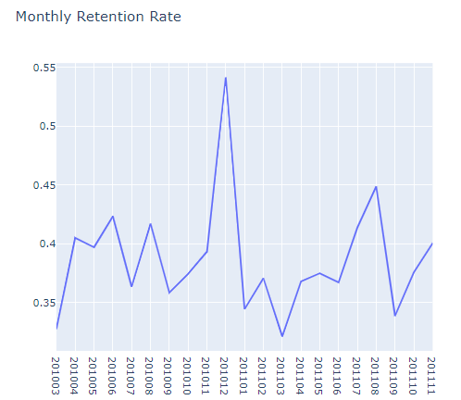
New Customer Ratio & Retention Rate

Slide 7
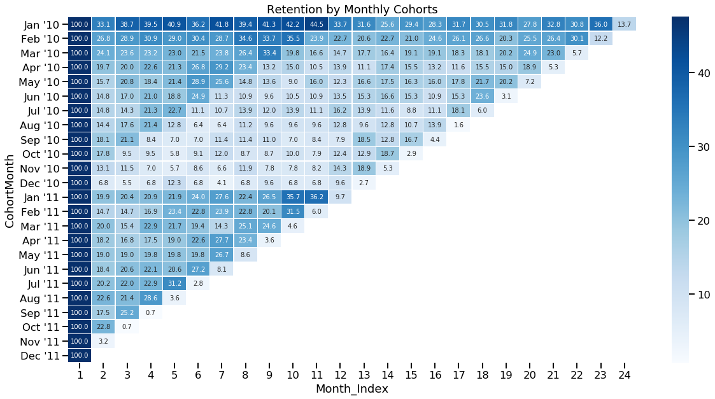
Cohort Based Retention Rate

Slide 8
Customer Segmentation
Consumers benefit because:
They feel like companies have their best interest in mind.
Content and products address and fulfill their needs.
Companies benefit because they can:
Optimize their marketing spend
Increase customer lifetime value (CLV)
Improve customer service and customer experience
Implement optimal marketing channel selection for their each segment
Improve product features and offerings
Identify and cater to most profitable customers
Here are the disadvantages of clustering:
Customer groups created may not be easily interpretable.
If data is not based on consumer behaviour (such as products or services purchased), it may not be clear how to use the clusters that are found.

Slide 9
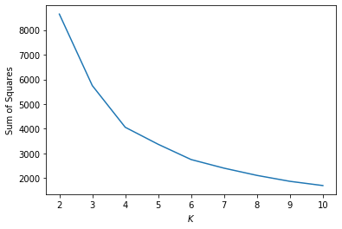

Select the optimal number of clusters
Silhouette
The Elbow Method with the Sum of Squared Errors (SSE)

Slide 10
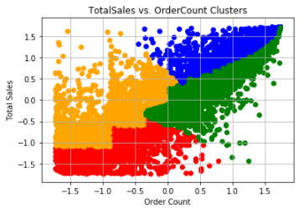
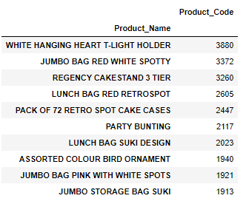
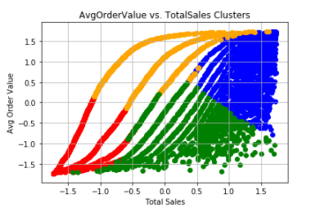
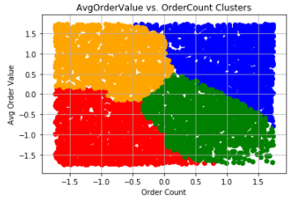
Visualizing Clusters and Find the best-selling item by segment

Slide 11
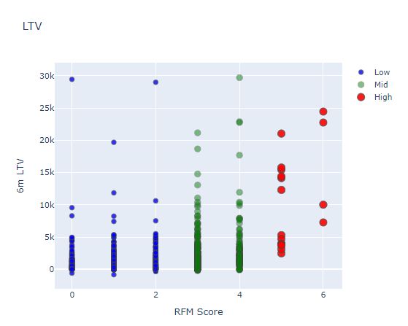
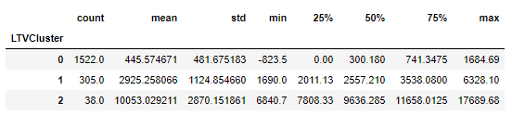
Customer Lifetime Value Prediction (CLV)
Lifetime Value =Total Gross Revenue - Total Cost
Lifetime Value Prediction The characteristics of each clusters

Slide 12
Multi-Classification Model
Logistic Regression (LR)
Gaussian Naive Bayes (NB )
Random Forest Classifier (RF)
Support Vector Classifier (SVC)
DecisionTreeClassifier (Dtree)
XGBoost Classifier (XGB)
K Neighbors Classifier (KNN)

Slide 13
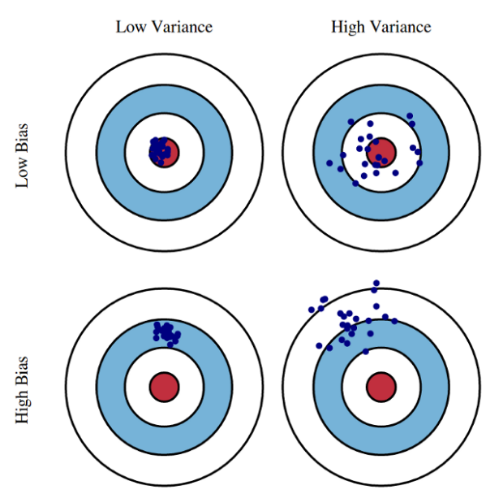
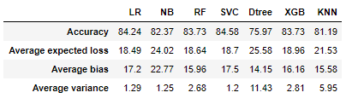
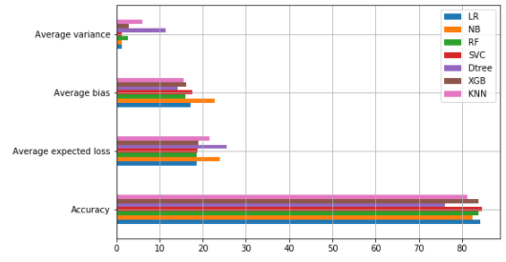
Bias-Variance Tradeoff - Models

Slide 14
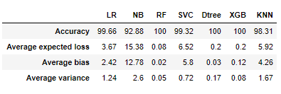
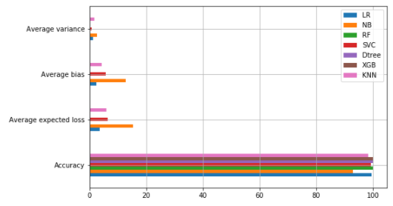
Before and after Normalizing the data

Slide 15
Exploratory Data Analysis EDA
Concluding Remarks
The dataset does not feature any missing or erroneous data values, and all features are of the correct data type apart from the “Invoicedate”, which was restored to date.
The dataset is imbalanced with the majority of observations describing sales in GB.
About 91% of sales is in GB
Around 83% of the products’ prices are less than 5 unit price
We saw 36.5% growth previous month
Monthly Active Customer number dropped to 820 from 1,368 (-40.1%)
Order Count is also declined in Dec 2010 (455k to 251, -44.8%)
The monthly order average increased for Dec (15.8 to 17.8)
Existing customers are showing a positive trend and tell us that our customer base is growing but new customers have a slight negative trend
Monthly Retention Rate significantly jumped from Nov 2010 to Dec 2010
First month retention rate in 2010, was 13.7% of our customers retain with us.
Silhouette and the Elbow Methods can find four clusters
Good Value Customers %26.65, Potential Customers %47.07 and Customers at risk %26.28
we can make recommendations of Other Items You Might Like to customers within this segment.
Positive correlation between RFM score and 6m LTV. High RFM score means high LTV.
LTV_Cluster 2 is the best with average 10.5k LTV whereas 0 is the worst cluster with 445.
We see that 3 months Revenue, Frequency and Monetary RFM scores will be helpful for our machine learning models
7 machine learning models are used for this case study: LR, NB, RF, SVC, Dtree, XGB and KNN
The best performing models in this case are SVC, LR, XGB and RF respectively.
we can see that LR has the lowest Bias and SVC has the lowest variance.
Applying hyper-parameter improved the models slightly, by about 1 to 5%
Normalizing the data improved the models significantly, reaching 100% in some models.
We can save all our machine learning models in a pickle to use/call it for production.

Slide 16
Possible future actions
Adding more features could potentially increase the number of use cases that we do. For example if we have churn field we can build Churn Prediction model.
Adding more data would improve the machine learning models

Slide 17


